Slide 1


Slide 2

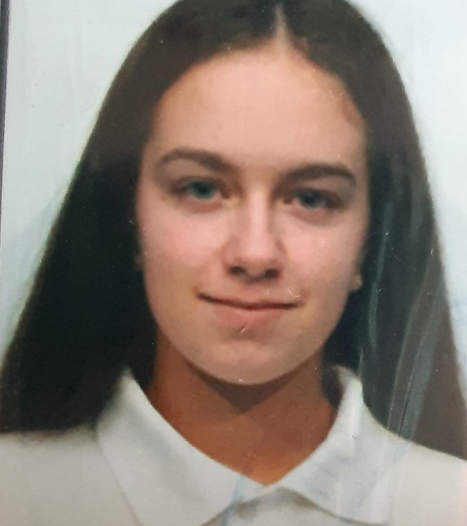


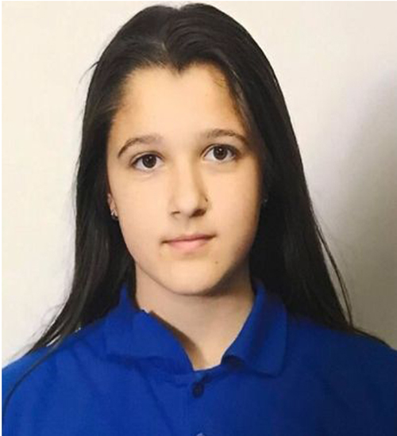

OUR TEAM
Valeria Yaneva
Scrum Trainer
Iliyana Michevska Back-end
Day 3
Vanesa Kardzheva Back-end
Zhanet Petkova
QA Engineer

Slide 3
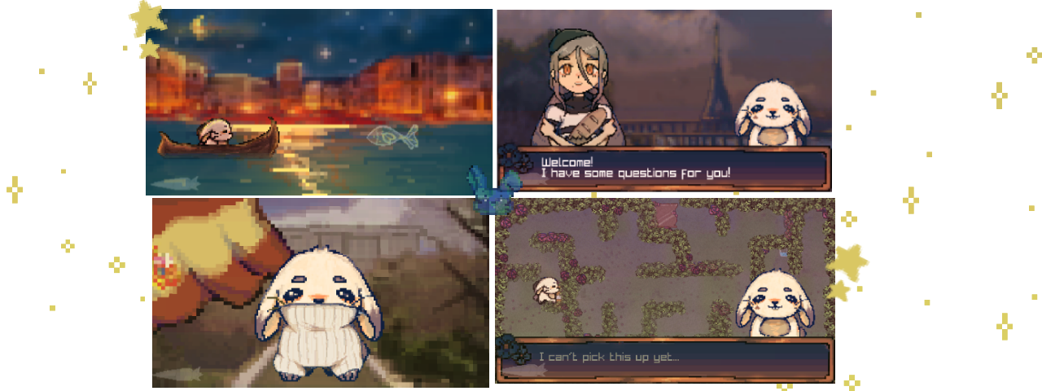
OUR IDEA

Slide 4

STAGES OF DEVELOPMENT
Testing the code
Idea
Presentation
Building the game
Finished
product

Slide 5










USED PROGRAMS

Slide 6

Let’s jump to the project!

Slide 7
Any questions?

Slide 8
Thank you for your attention!

